Slide 1

Candidate Red Flags, Vetting and Resume Formatting

Slide 2


Objectives For Today
Learn what to look for in LinkedIn profiles and resumes that may indicate potential concerns.
Practice how to discuss these concerns effectively with candidates.
Develop the skills to ask targeted questions that uncover red flags.
Learn strategies to verify candidate authenticity and detect falsified information.
Understand how to prepare and format resumes professionally for submission.

Slide 3



Why Is This So Important?
Notes:
We want to ensure we aren’t submitting or hiring people that aren’t who they say they are. This can cause us a lot of problems and even get us kicked off a client list or in legal trouble if we don’t do our due diligence. It will also help with our reputation with the marketplace.
We want our clients to trust that the candidates we say we have vetted have actually been vetted! We have to build trust to have a good relationship.
It will also help us save time and resources by finding these issues up front so we aren’t wasting our time on unqualified or dishonest candidates.

Slide 4


What Might Be A Red Flag On LinkedIn

Slide 5
LinkedIn Red Flags
Account Opened Recently
No Picture
No Last Name
Less Than 500 Connections
No Experience Or Postings

Slide 6

What Might Be A Red Flag On A Resume

Slide 7
Resume Red Flags
Tell me about…I noticed a gap in… can you share what you were doing…
Gaps In Employment
Offer your assistance and expertise vs criticism.
Formatting, Grammatical, Spelling Errors
Tenure Of Jobs
Address directly: Tell me about company XYZ and what they do…
Can you tell me about the transitions between roles and what prompted them?
Legitimate Companies?
Dig in: I see you went from a lead role to an individual… tell me more
Can you walk me through a project where you used *insert tech*? What was your role?
I noticed there was a gap between graduation and working… can you tell me more?
Mismatched Job Level Or Odd Career Progression
Generic List Of Technologies Or Overused Buzzwords
Degree/
Graduation And Employment Alignment
Notes:
How could you address these with the candidate?

Slide 8

What Might Be A Red Flag In A Convo

Slide 9
Conversation Red Flags
Can’t explain their experience
Defensive
Passively Looking
Won’t Provide References
Hesitant About Background Or Technical Checks

Slide 10

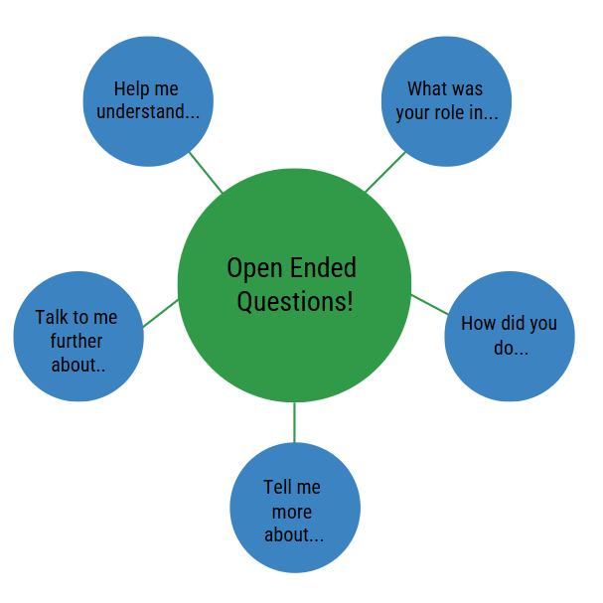
Common Theme For Addressing Red Flags

Slide 11
Internal Process
Verify Their LinkedIn Matches Their Resume
Look For Red Flags On LinkedIn and Resume
Verify References

Slide 12
How To Verify References
Make Sure They Are Managers (Not Peers, Friends, etc.)
Make Sure They Gave You Work Email Addresses
Verify Reference Exists On LinkedIn With Same Job And No Red Flags

Slide 13
Formatting Best Practices
What Tense To Use?
Make Sure The Dates Line Up
Clean Lines And Bullets Aligned Page To Page
Don’t Make Margins Smaller To Fit More
Roles Should Be In Reverse Chronological Order
Notes:
Use present for ongoing job/current role- monitor patient vitals, administer mediciations to post op patients
Use past tense for a job that is ended- assisted, collaborated
Don’t mix present and past tense in the same job unless: You’re describing ongoing duties (present) and completed accomplishments (past). Ex: provide direct care to 6+ patients per shift. Trained 3 new hires in proper charting procedures

Slide 14


Editing A Resume
Do it the right way
Get rid of/ shorten the technical or professional summary (this is often duplicated in the description of each position anyway)
Take out company descriptions
If positions are more than 10 years old, cut down those descriptions (or remove them completely, but keep company, position, and dates)
Limit excess spacing

Slide 15


